Slide 1
Hive table operations

Slide 2
Creating Tables and Loading Data
Remember Schema on Read?
Loading data just involves copying file instead of inserting data into DB a line at a time.
Very fast
No checking if the file conforms to the schema
Can get a nasty surprise when querying data later.
When you load data into a table created in Hive it is moved into Hive’s warehouse directory
In the above example the file hdfs://user/tom/data.txt will be moved into warehouse directory for managed_table table, which is hdfs://user/hive/warehouse/managed_table

Slide 3
Dropping data
When a table is dropped its metadata and data are deleted.

Slide 4
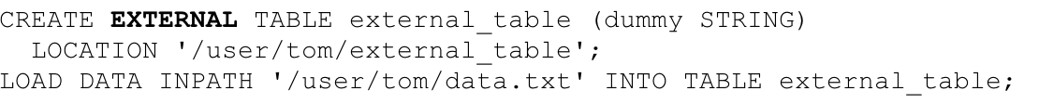
External Table
Hive will just update its metadata to say this table resides in the external directory/file you have specified
It will not even check that the file actually exists
Allows you to lazily create the data after creating the table.
When the external table is dropped, Hive will leave the data untouched and just delete the metadata

Slide 5
When to Use External Table?
If you are using Hive and other tools on the same dataset
A common pattern
Use an external table to access an initial dataset stored in HDFS
Transform data and store into managed Hive table
Transform data: dropping some columns
Transform data: dropping some rows
Etc.
External table can also be used by Hive to export data.
External table can be used to associate multiple schemas with the same dataset.

Slide 6
Partitions
dt (date) | ts (timestamp) | line
2001-01-01 | 122030 | Good day
2001-01-01 | 012982 | I am happy
2001-01-02 | 012022 | This is a good subject
2001-01-02 | 020811 | I like computers
2001-01-02 | 180211 | I don’t like computers
P1
P2
Hive allows you to horizontally partition a table into multiple files.
One file per partition
The data for each partition is physically stored in separate locations.
This way it will be faster to lookup data.
For example a query that is just interested in data for 2001-01-01 will only need to access one file containing only data with date 2001-01-01.
For the above example we can create the table as follows:
CREATE TABLE logs (ts BIGINT, line STRING)
PARTITIONED BY (dt STRING);
We can then load a file into one of the partitions as follows:
LOAD DATA LOCAL INPATH ‘input/hive/partitions/file20010101’
INTO TABLE logs
PARTITION (dt = ‘2001-01-01’);

Slide 7
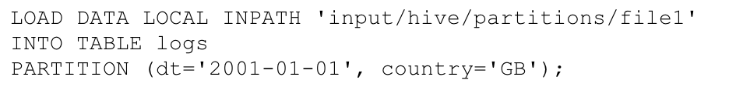
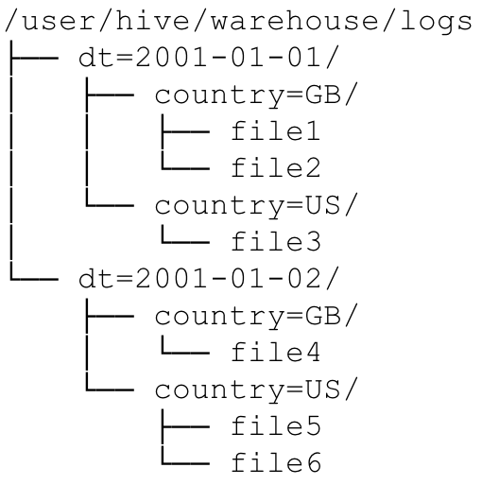
Partitions
We can partition the data by more than one field.
The Hive directory structure for the above example is the following:

Slide 8
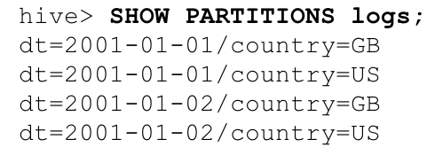
Show Partitions in a table

Slide 9
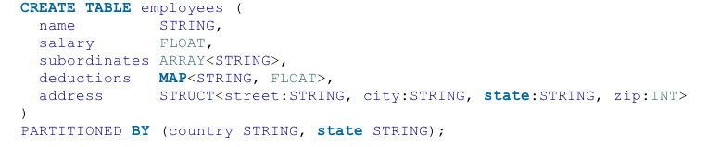

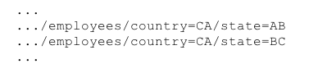
The partitioning attribute does not need to be inside the table itself
Note the country and state columns do not need to be stored inside the table itself. This information is actually encoded inside the directory names themselves.
So when we search for country = ‘US’ and state = ‘IL’ we do not need to look for these values inside the table since it should be encoded inside the directory names themselves.

Slide 10
Partitioned table logically includes the partitioned column
CREATE TABLE employee(emp_id INT, name STRING) PARTITIONED
BY(country STRING);
Actually creates a table that logically contains the country column like the following.
CREATE TABLE employee(emp_id INT, name STRING, country STRING)
So we can then write queries like
SELECT emp_id, country FROM employee
WHERE country = ‘Australia’

Slide 11
Partitions
You may have the following question
What if we all my data is in one file and we want to split it into different partitions?
The answer is you can not use the Load command since load just copies files into Hive directories.
It can not split a file into multiple files.
See the next slide for the solution

Slide 12
Partitions using INSERT
CREATE EXTERNAL TABLE staged_employees (cnty STRING, st STRING)
LOCATION ‘/user/tom/external_table’;
LOAD DATA INPATH ‘/user/tom/data.txt’ INTO TABLE staged_employees;
CREATE TABLE employees (cnty STRING, st STRING)
PARITITIONED BY (country STRING, state STRING);
INSERT OVERWRITE TABLE employees
PARTITION (country = ‘US’, state = ‘OR’)
SELECT * FROM staged_employees se
WHERE se.cnty = ‘US’ AND se.st = ‘OR’;
In the above example we first create an external table called stage_employees and then link our external input data with it.
Next we create a partitioned table called employees
Next we select all the rows of the staged_employees table which have the country set to US and state set to OR into the corresponding partition in the employees table.
The OVERWRITE command overwrites the previous contents of the partition as it inserts the new tuples.

Slide 13
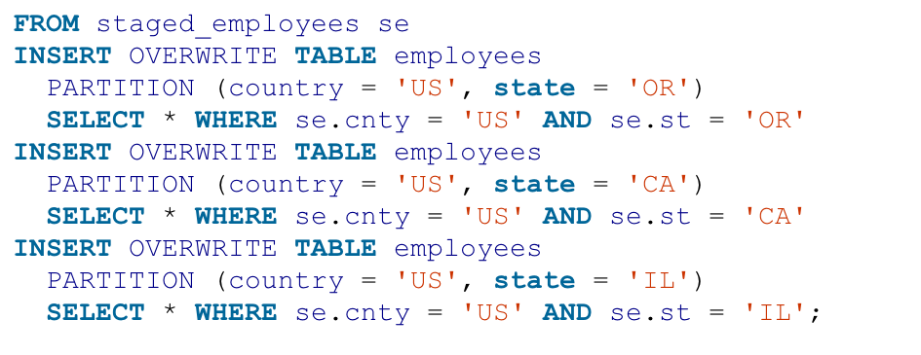
Partitions using INSERT
We can write the above to insert data into the other partitions.
But the above is quite tedious, we have 52 states for the US we would need to write 52 more INSERT statements just for the US alone.
Is there a better way?

Slide 14
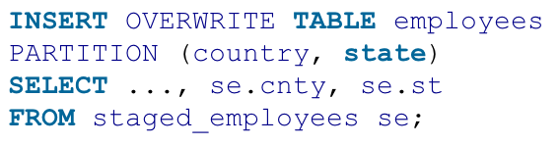
Dynamic Partition Inserts
The above example infers the partitions to create based on query parameters.
Hive determines the values of the partition keys, country and state, from the last two columns of the SELECT clause.

Slide 15
Append
We can append a row into a table without overwriting it by using
INSERT INTO TABLE <table name>
Instead of
INSERT OVERWRITE TABLE <table name>

Slide 16
Buckets (clustering)
Tables or partitions can be split into buckets
Bucketing effectively hash partitions the data.
Three reason for using buckets
Partitioning sometimes produces too many files (overwhelms the file-system)
Use bucketing to produce less files.
Enable more efficient queries
In particular joins are more efficient
We will demonstrate this soon.
More efficient sampling.
The above example splits the table buckets_users into 4 buckets
Rows are placed into buckets based on the user id attribute
It will use a hash function to determine which user ids go into which bucket
Rows will be effectively placed evenly into the buckets

Slide 17

Buckets
Bucket 0, filename: 00000_0 contains
Bucket 1, filename: 00000_1 contains
Bucket 2, filename: 00000_2 contains
Bucket 3, filename: 00000_3 contains
User id | Name
10 | Matt
7 | Phil
24 | Steve
42 | Sam
19 | Arthur
5 | Caroline
21 | Zhen
16 | John
24 | Steve
16 | John
5 | Caroline
21 | Zhen
The above command takes the users table and writes the rows into our bucketed_users table.
Each bucket will store the data in a different file.
In this example we are using the following simple hash function:
User id % 4
10 | Matt
42 | Sam
7 | Phil
19 | Arthur

Slide 18

Too many files using partitioning
This create table command would create too many directories if there are many different users for each date (dt).
The reason is it creates one directory per dt, user_id pair.
Hive will not let you create any more directories after a certain limit has been reached.
We can reduce the number of directories produced by using bucketing for the user_id attribute.
In the above example we limit the number of buckets used to store user_ids to just 96.

Slide 19
Buckets good for join
If both tables involved in a join are split into the same number of buckets on the join attribute then we can do a map-side join.
Note this is different from both the replicated join and reduce-side join we talked about earlier.
The map-side join is faster the normal replicated join since no reducers are needed.
The map side join is a hint embedded into an SQL C-style comment.

Slide 20
Data sorted in Buckets
The data in buckets can be sorted by one or more columns
If the data is sorted within buckets then the map-side join can be even more efficient
Merge join per bucket

Slide 21
Buckets good for sampling
Sampling is much quicker after the data is in buckets.
Assume for the above example the bucketed_users table is clustered into 4 buckets.
For example if we just want to take a 25% sample of the data we just use the first command above.
It just involves taking the rows in one of the 4 buckets.
Similarly if we want to take a 50% sample we just need to use the second command
It just involves taking the rows in two of the 4 buckets.

Slide 22
Storage Format
Hive supports row format and file format
Row format
store data in Hive internal format, like what databases do
Super optimized
Dictates how rows and fields are stored
SerDe – Serializer-Deserializer
Deserialize a row from bytes into Hive internal representation of the row as an object
Serialize does the opposite to the deserializer
Reads data in using Hadoop input format and the deserializes using SerDe.
Allows attributes to be deserialized lazily
Compression available

Slide 23
Storage Format
File format
Makes Hive compatible with the rest of Hadoop.
Can read data outputted from MapReduce
Can write data that can be read by MapReduce.
Many different formats available
Text file
XML, JSON formats
Sequence files (Hadoop objects stored in binary format)
Compression option available
Row-oriented binary format
Column-oriented binary format

Slide 24

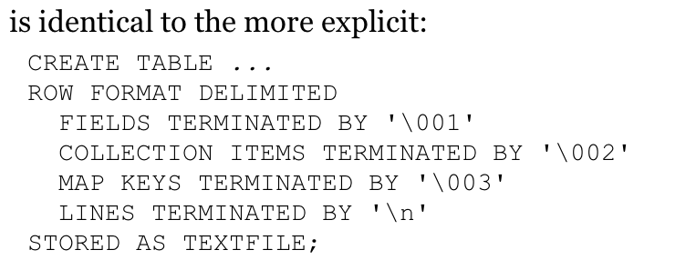
Default Storage Format
Default storage format is delimited text with one row per line
Default field delimiter is not tab but Control-A (^A)
Default ARRAY or STRUCT delimiter is Control-B
Default map key delimiter is Control-C
Default row delimiter is the newline character.
By default SerDec uses LazySimpleSerDe.
This means it only deseralizes a field when it is accessed.

Slide 25
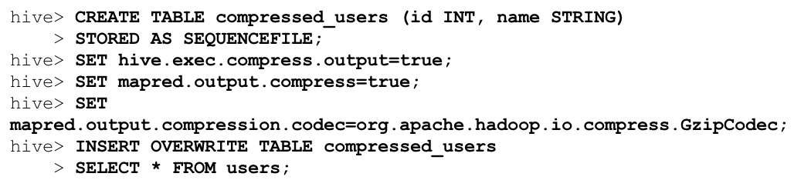
Binary storage formats: Sequence files
Hadoop’s sequence file format is a general-purpose binary format for sequence of records (key-value pairs)
STORED AS SEQUENCEFILE
One of the really nice things is that you can compress sequence files like below

Slide 26
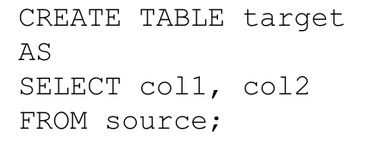
Create Table As Select
Creates a table based on the result of a query

